Slide 1
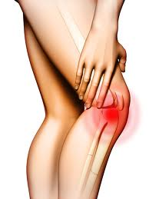
Gender-based health and weight loss beliefs in knee osteoarthritis patients

Slide 2
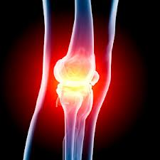
Osteoarthritis: A chronic joint condition
Affects 12.5% of the Australian population > 45 yrs
Cost approximately $1.2 billion in 2001

Slide 3
Knee OA, Obesity & Women
Effects women > men
Obesity main modifiable risk factor
Weight loss →improved symptoms
BMI → ↑symptom severity, particularly in women
Despite this, those with OA still gain weight !

Slide 4
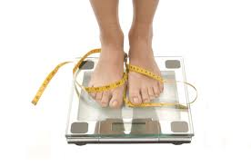
Study aims
Thus this study aims to investigate gender-based health and weight loss beliefs of those with knee osteoarthritis in order to develop a more effective weight loss intervention strategy for female sufferers

Slide 5
Methods
Participants:
100 patients attending a rheumatology or orthopedic clinic with symptomatic knee OA
Aged 50 – 70 years
Data collection:
Two part questionnaire:
Health and weight loss beliefs
Knee symptoms (pain, stiffness and function)

Slide 6
Data Analysis
Data examined separately for men and women
Analysed using SPSS
Statistically significance: p<0.05

Slide 7
Characteristics of Study Population

Slide 8
Body Weight Satisfaction*
* Not significantly different

Slide 9
Body Shape Satisfaction*
*P=0.008 for trend

Slide 10
Weight Change in the Last 6 Months*
*P=0.008 for trend

Slide 11
Desired Weight*
* Not significantly different

Slide 12
Dieting Frequency*
*P=0.013 for trend

Slide 13
Factors Causing Weight Gain
*
**
*P=0.013; **P=0.031

Slide 14
Reasons to Exercise
*
*P=0.0004

Slide 15
Level of agreement with the statement:
A campaign in my locality aimed at increasing participation in physical activity/exercise would be effective in encouraging me to do more.

Slide 16
Level of Agreement*
*P=0.009 across trend

Slide 17
Limitations
Cross-sectional designed study
Use of questionnaire
English participants only

Slide 18
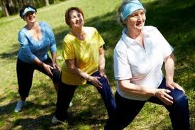
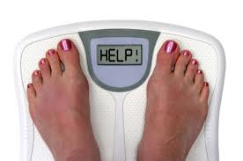
Conclusions
Women:
Diet more yet frequently gain weight
Believe in exercise to control weight
Would be receptive to targeted intervention

Slide 19
Therefore…
A targeted intervention campaign focused on dietary education and exercise participation may be effective in preventing weight gain and promoting weight loss among women with knee OA

